Slide 1

Exploratory Data Analysis
Project : IPL Data Analysis
(2008-2024)
Presented by Varshith Reddy Surakanti

Slide 2




Project Overview: Revealing Insights from IPL Data
Large-Scale Cricket Data
Data-Driven Understanding
The Indian Premier League (IPL) produces a vast amount of structured cricket data every season, making it an ideal candidate for analytical exploration.
The objective of this project is to analyze match outcomes and player performances using a data-driven approach rather than assumptions.
Exploratory Data Analysis (EDA)
Key Datasets Used
This project applies Exploratory Data Analysis techniques to identify patterns, trends, and relationships hidden within IPL data.
Matches – match-level information such as teams, venue, toss, and results
Deliveries – detailed ball-by-ball data capturing runs, wickets, and player actions

Slide 3
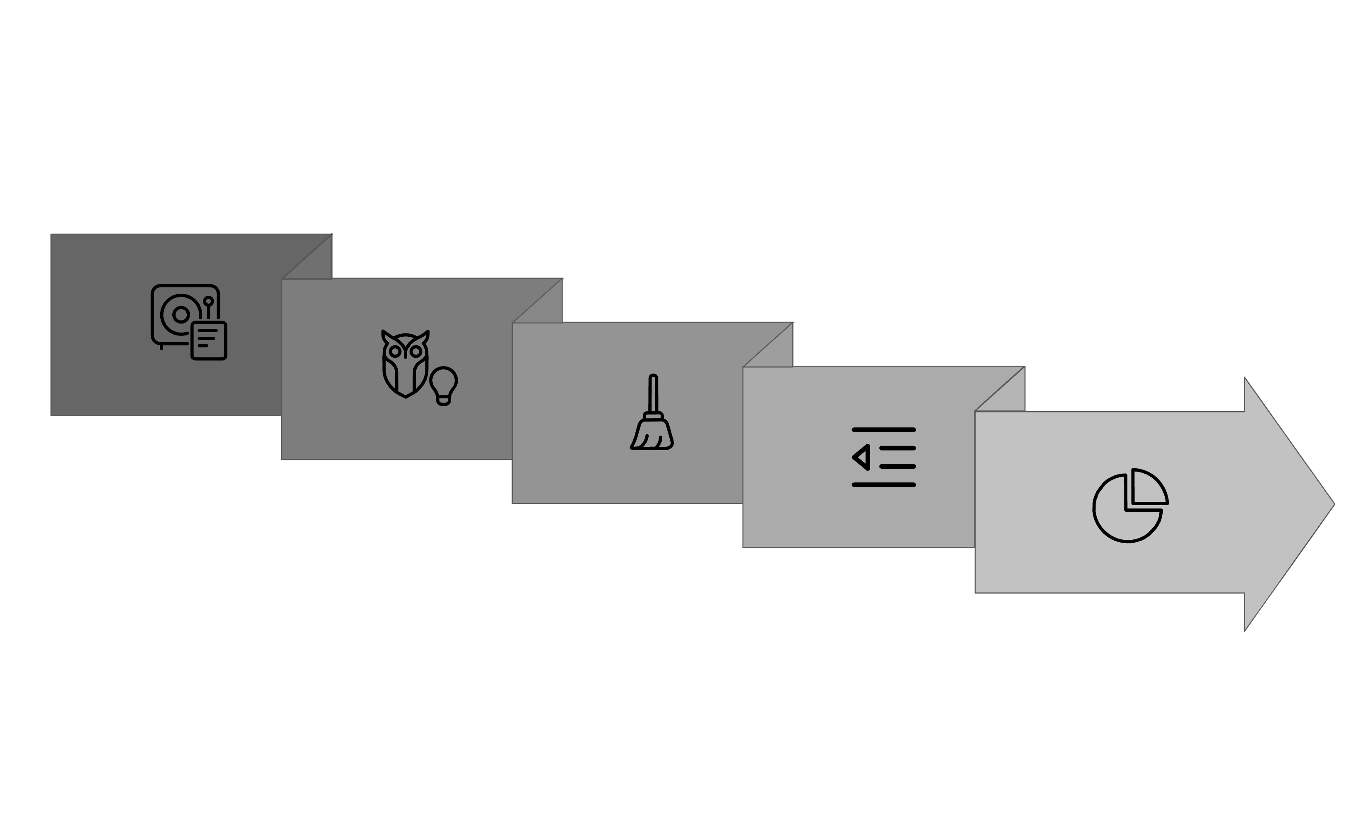





The EDA Journey: Our Workflow
Import
Clean
Analyze
Understand
Outlier Treatment
This structured approach ensures a thorough and reliable analysis, moving from raw data to actionable insights.

Slide 4
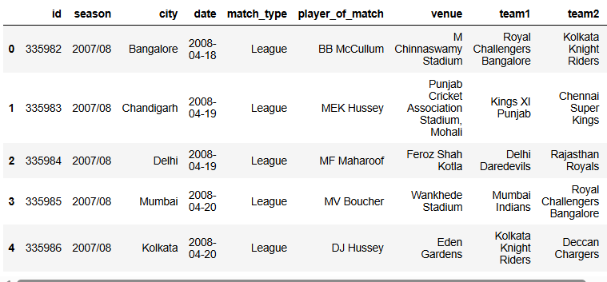
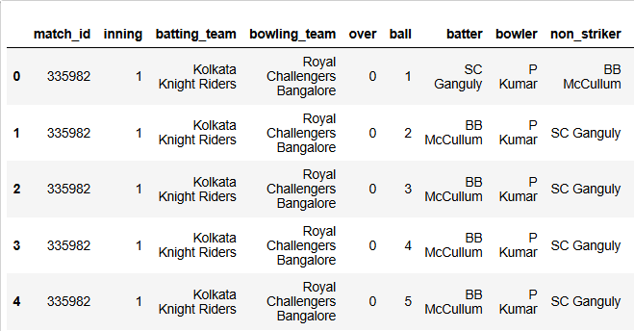
Diving into the Data: Datasets Overview
The datasets span from IPL 2008 to 2024, capturing long-term trends and evolution in gameplay.
Matches Dataset
Deliveries Dataset
Contains match-level information
Contains ball-by-ball details of each match
Includes season, teams, venue, toss details, match result, and win margins
Includes batsman, bowler, runs scored, extras, and dismissals
Useful for analyzing overall match trends and outcomes
Enables in-depth analysis of player performance and scoring patterns
Both datasets are structured and linked using a common match_id, allowing combined analysis.

Slide 5



Importing Data with Python
Python & Pandas
CSV Loading
Initial Checks
Leveraged Python's Pandas library for efficient data manipulation and analysis.
Utilized read_csv() to load both the matches and deliveries datasets from their respective CSV files.
Performed immediate checks using shape, info(), and head() to grasp structure, size, and data types.
These initial steps are fundamental to understanding the raw data and preparing for subsequent analysis.

Slide 6
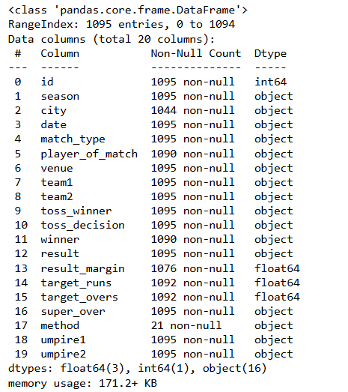


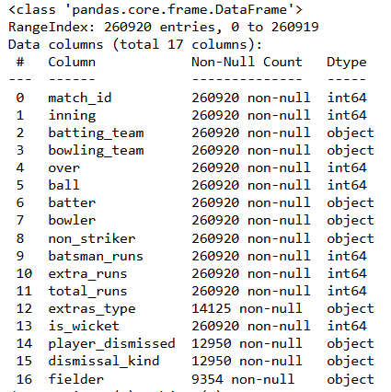


Understanding Our Data: Initial Exploration
Identifying Data Types
Each column was examined and classified as either categorical (teams, venue, players) or numerical (runs, wickets, overs).
Data Type Validation
Verified that all variables were stored in their correct formats, such as integers for runs and strings for team and venue names.
Missing Value Analysis
Checked and quantified missing values across both datasets to understand data quality and prepare appropriate cleaning strategies.
Relationship Check
Confirmed the one-to-many relationship between the matches and deliveries datasets using the common match_id, ensuring data integrity.

Slide 7
The Data Cleaning Process
Handling Missing Values
Standardization of Names
Missing values in non-critical columns were handled using appropriate imputation techniques to maintain data completeness without affecting match outcomes.
Team and venue names were standardized to eliminate inconsistencies and ensure uniform categorization during analysis.
Duplicate Record Removal
Cross-Dataset Consistency
Both datasets were checked for duplicate entries, and any redundant records were removed to ensure accuracy and reliability.
Verified that shared identifiers and related fields remained consistent across the matches and deliveries datasets, enabling accurate linkage and analysis.

Slide 8
First and second innings totals
Feature Engineering
Powerplay, Middle, Death overs scores
First and second innings totals
Missing values in non-critical columns were handled using appropriate imputation techniques to maintain data completeness without affecting match outcomes.
Team and venue names were standardized to eliminate inconsistencies and ensure uniform categorization during analysis.
Total Runs by Each Batsman
Strike Rate of Each Batsman
Both datasets were checked for duplicate entries, and any redundant records were removed to ensure accuracy and reliability.
Verified that shared identifiers and related fields remained consistent across the matches and deliveries datasets, enabling accurate linkage and analysis.

Slide 9
Outlier Treatment: Preserving Meaningful Extremes
Outlier Identification
Interpretation-Based Analysis
Outliers were identified using statistical methods such as boxplots and the Interquartile Range (IQR) technique on key numerical features.
Instead of removal, outliers were analyzed separately to understand their impact on match dynamics and player performance.
Robust Visualization
Nature of IPL Data
Used visualization techniques (boxplots, histograms with wide ranges) that naturally handle extreme values without distortion.
In sports analytics, extreme values often represent exceptional performances (e.g., high scores, large victory margins) rather than data errors.
No Outlier Removal
Outliers were intentionally retained, as removing them would eliminate important and realistic match scenarios from the analysis.

Slide 10
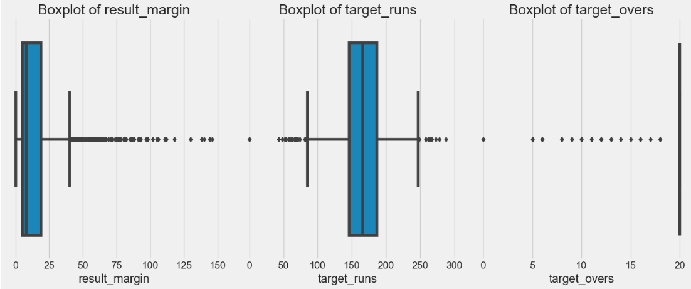
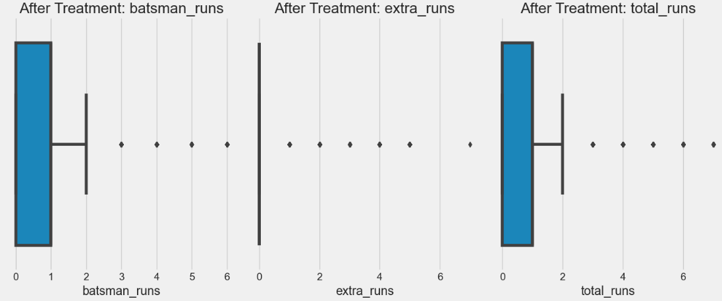
Outlier Assessment and Retention Strategy
Cleaned Matches Dataset
Cleaned Deliveries Dataset
Provides match-level context such as season, venue, teams, toss decision, and final result.
Enables analysis of strategic factors like toss impact, home advantage, and match outcomes over time.
Serves as the backbone for season-wise and venue-wise trends in the IPL.
Captures ball-by-ball details, allowing deep analysis of scoring patterns and wickets.
Enables phase-wise analysis (Powerplay, Middle Overs, Death Overs) and player performance insights.
Forms the basis for advanced metrics and feature engineering such as run rates, economy, and pressure phases.

Slide 11
Outlier Retention for Maintaining Data Integrity in IPL
Analysis
Outliers in IPL data are not errors; they are real match events that provide critical insights into the game's dynamic nature.
Meaningful Extremes, Not Errors
Reflecting Real Match Scenarios
In IPL data, outliers represent genuine match events rather than data inaccuracies, offering valuable insights into the dynamic nature of cricket.
Unlike conventional datasets, extreme values in cricket often capture exceptional performances or rare match situations.
Examples of Significance
Strategic and Analytical Value
Such outliers include unusually high innings totals, record-breaking individual performances, or large winning margins by dominant teams.
Retaining outliers enables a realistic understanding of extreme scenarios, supporting better strategic analysis, decision-making, and fan engagement.
Hence, all identified outliers were preserved for analysis.

Slide 12
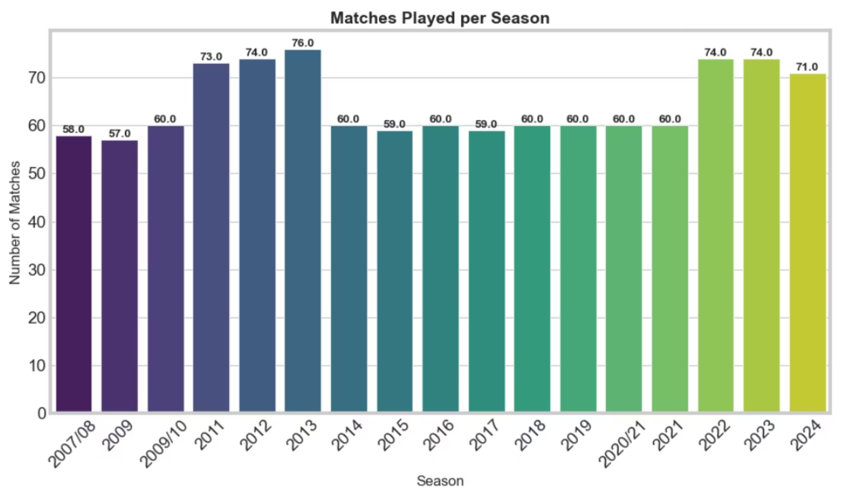
EXPLORATORY DATA ANALYSIS:
Univariate Analysis (Single Variable Analysis)
Matches played per season
Growth trend: Early seasons had fewer matches; later seasons expanded with more teams.
Peak seasons: Certain years (e.g., 2011, 2014, 2019) show spikes due to format changes.
Consistency: After stabilization, match counts remain fairly steady across seasons.

Slide 13
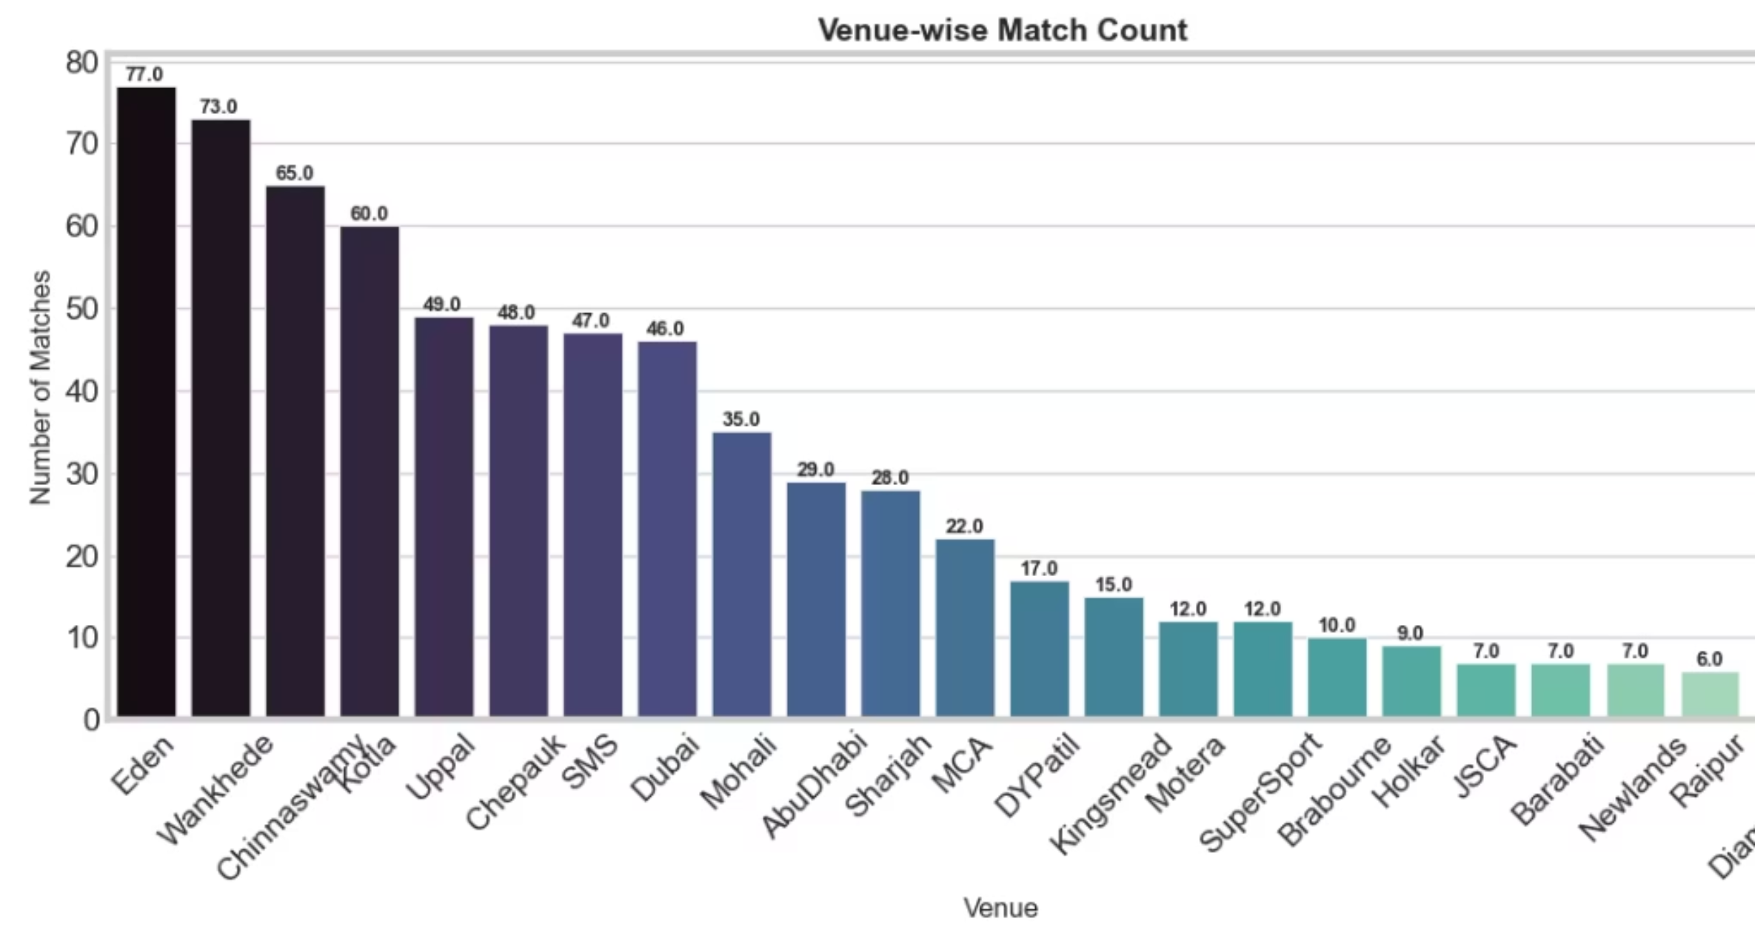
Univariate Analysis
Venue-wise Match Count
Popular venues: Stadiums like Wankhede, Eden Gardens, and Chinnaswamy dominate hosting.
Regional spread: Shows IPL’s expansion beyond traditional cricket hubs.
Neutral venues: UAE venues (Dubai, Abu Dhabi, Sharjah) appear during pandemic seasons.

Slide 14
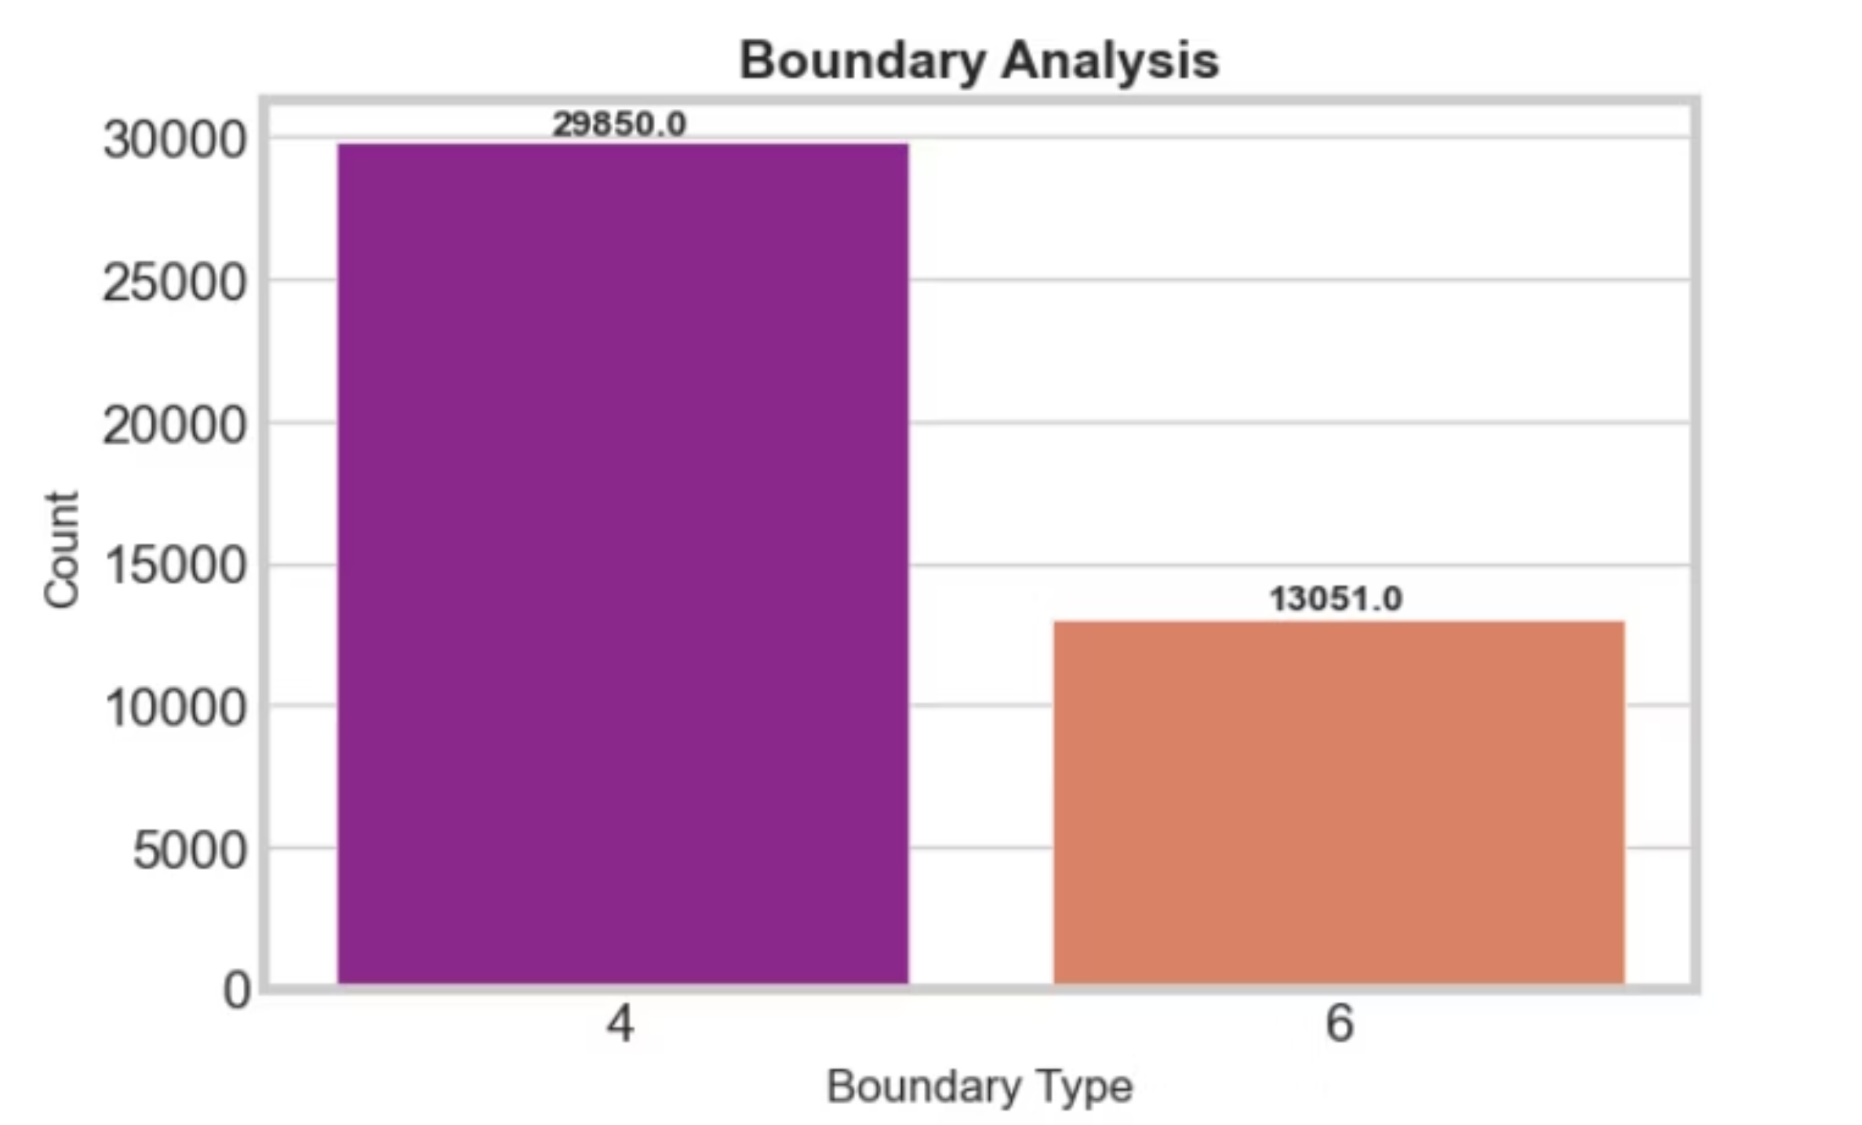
Univariate Analysis (Single Variable Analysis)
Boundary Analysis
4s vs 6s: Fours are consistently more frequent than sixes.
Batting style: Indicates reliance on ground shots vs power hitting.
Entertainment factor: Sixes, though fewer, are crowd-pullers and highlight aggressive batting.

Slide 15
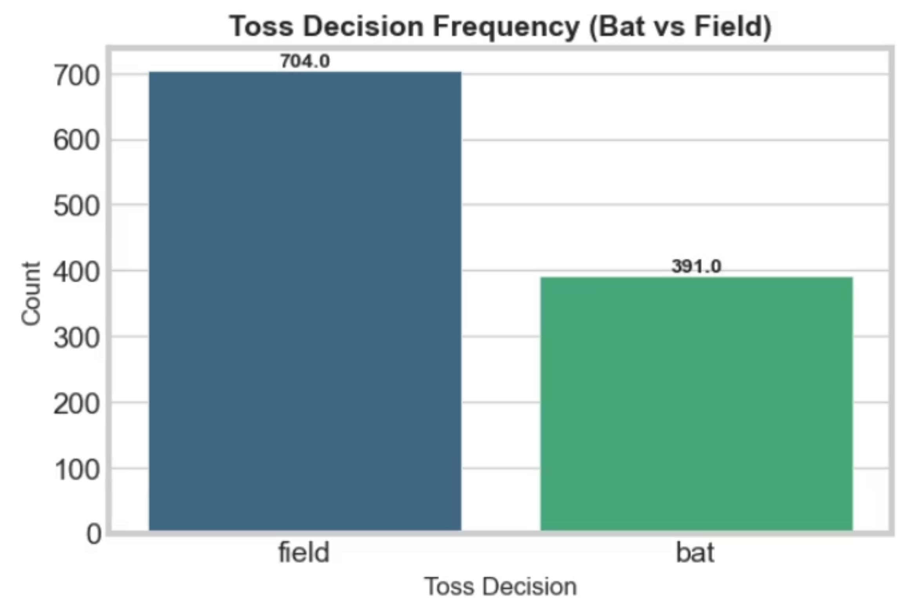
Univariate Analysis (Single Variable Analysis)
Toss Decision Frequency (Bat vs Field)
Fielding preference: Teams often choose to field first, reflecting T20 chasing strategies.
Bat-first cases: Still present, usually in batting-friendly pitches.
Trend insight: Over time, “field” has become the dominant toss decision.

Slide 16
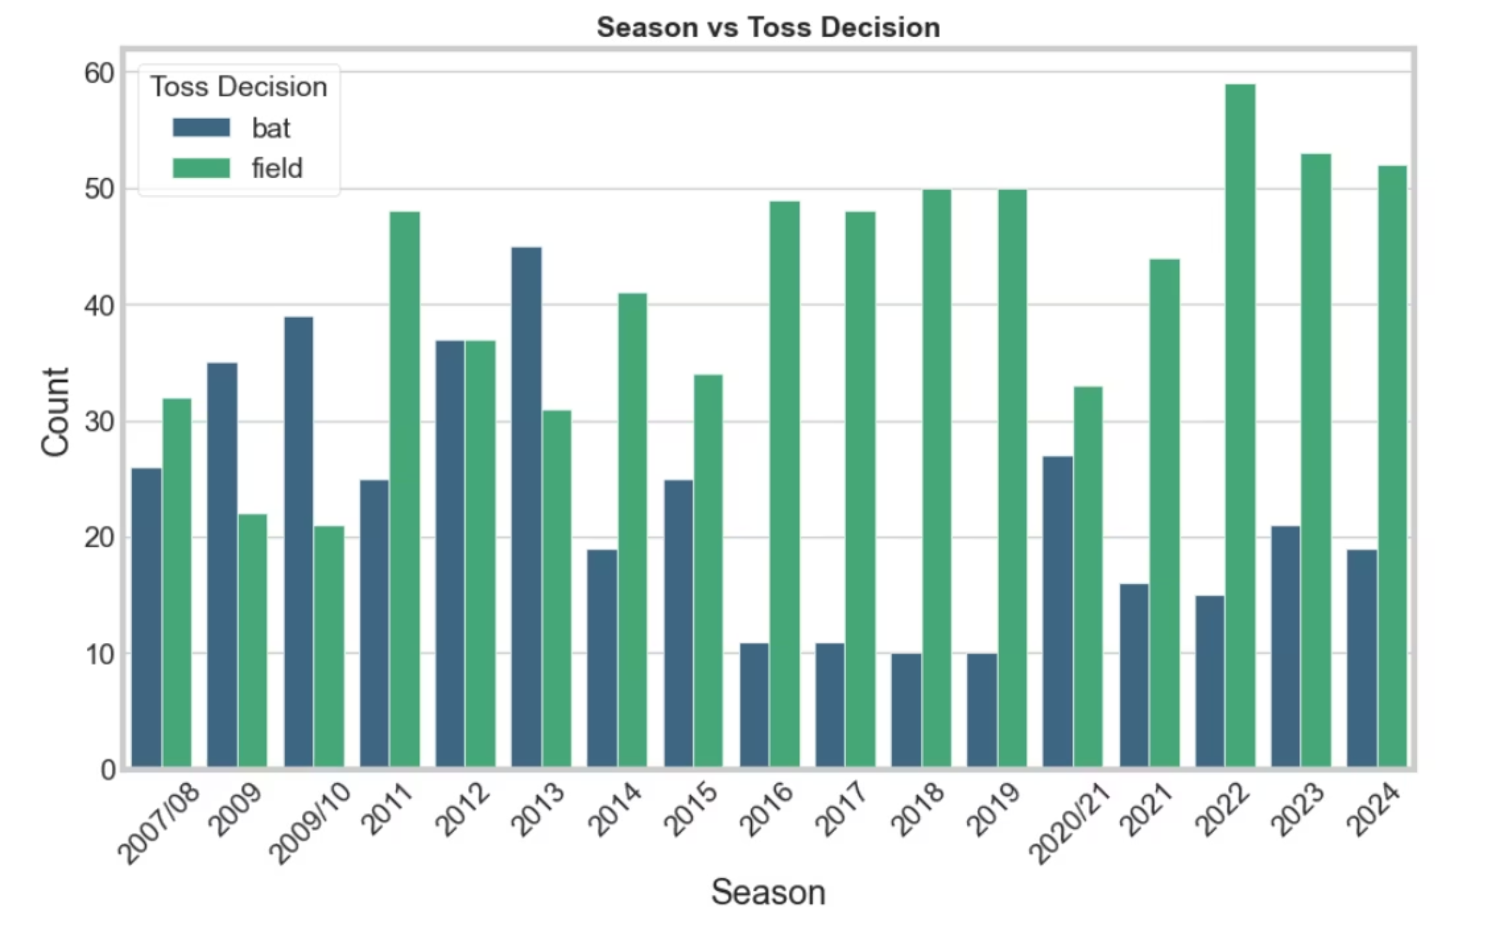
Bivariate Analysis (Two Variable Analysis)
Season vs Toss Decision
Fielding preference grows over time: Teams increasingly choose to field first in later seasons, reflecting chasing strategies in T20 cricket.
Bat-first decisions dominate early years: In initial seasons, batting first was more common due to less predictable pitches.
Strategic shift: The rise of analytics and chasing confidence changed toss decisions season by season.

Slide 17
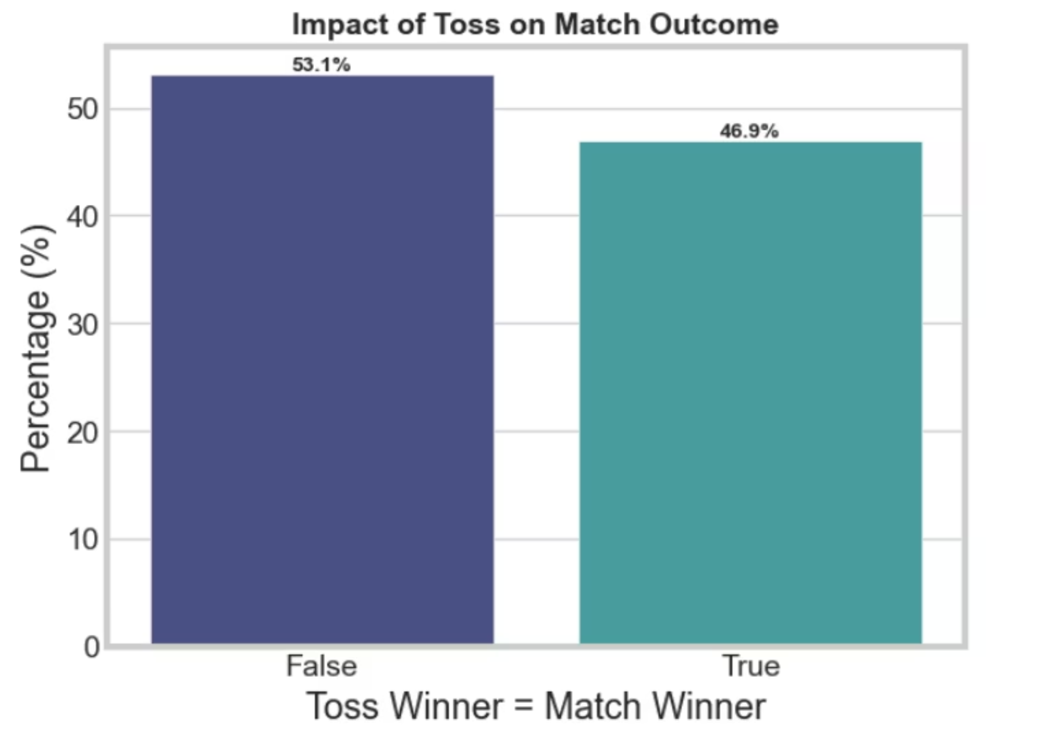
Bivariate Analysis (Two Variable Analysis)
Impact of Toss on Match Outcome
Toss advantage is limited: Winning the toss does not strongly guarantee winning the match — correlation is weaker than expected.
Chasing bias: Toss winners who choose to field often align with match wins, especially in high-scoring venues.
Balanced outcomes: Roughly half of toss winners lose the match, showing skill outweighs toss luck.

Slide 18
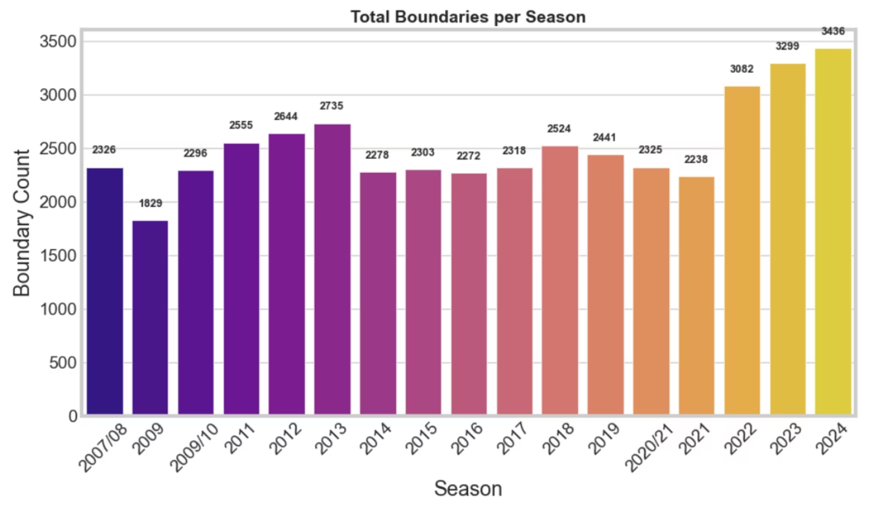
Bivariate Analysis
Total Boundaries per Season
Boundaries increase over time: Later seasons show higher boundary counts due to batting depth and smaller grounds.
Rule changes impact: Powerplay restrictions and fielding rules boosted boundary frequency.
Entertainment factor: Growth in sixes highlights the evolution of aggressive batting styles in T20 cricket.

Slide 19
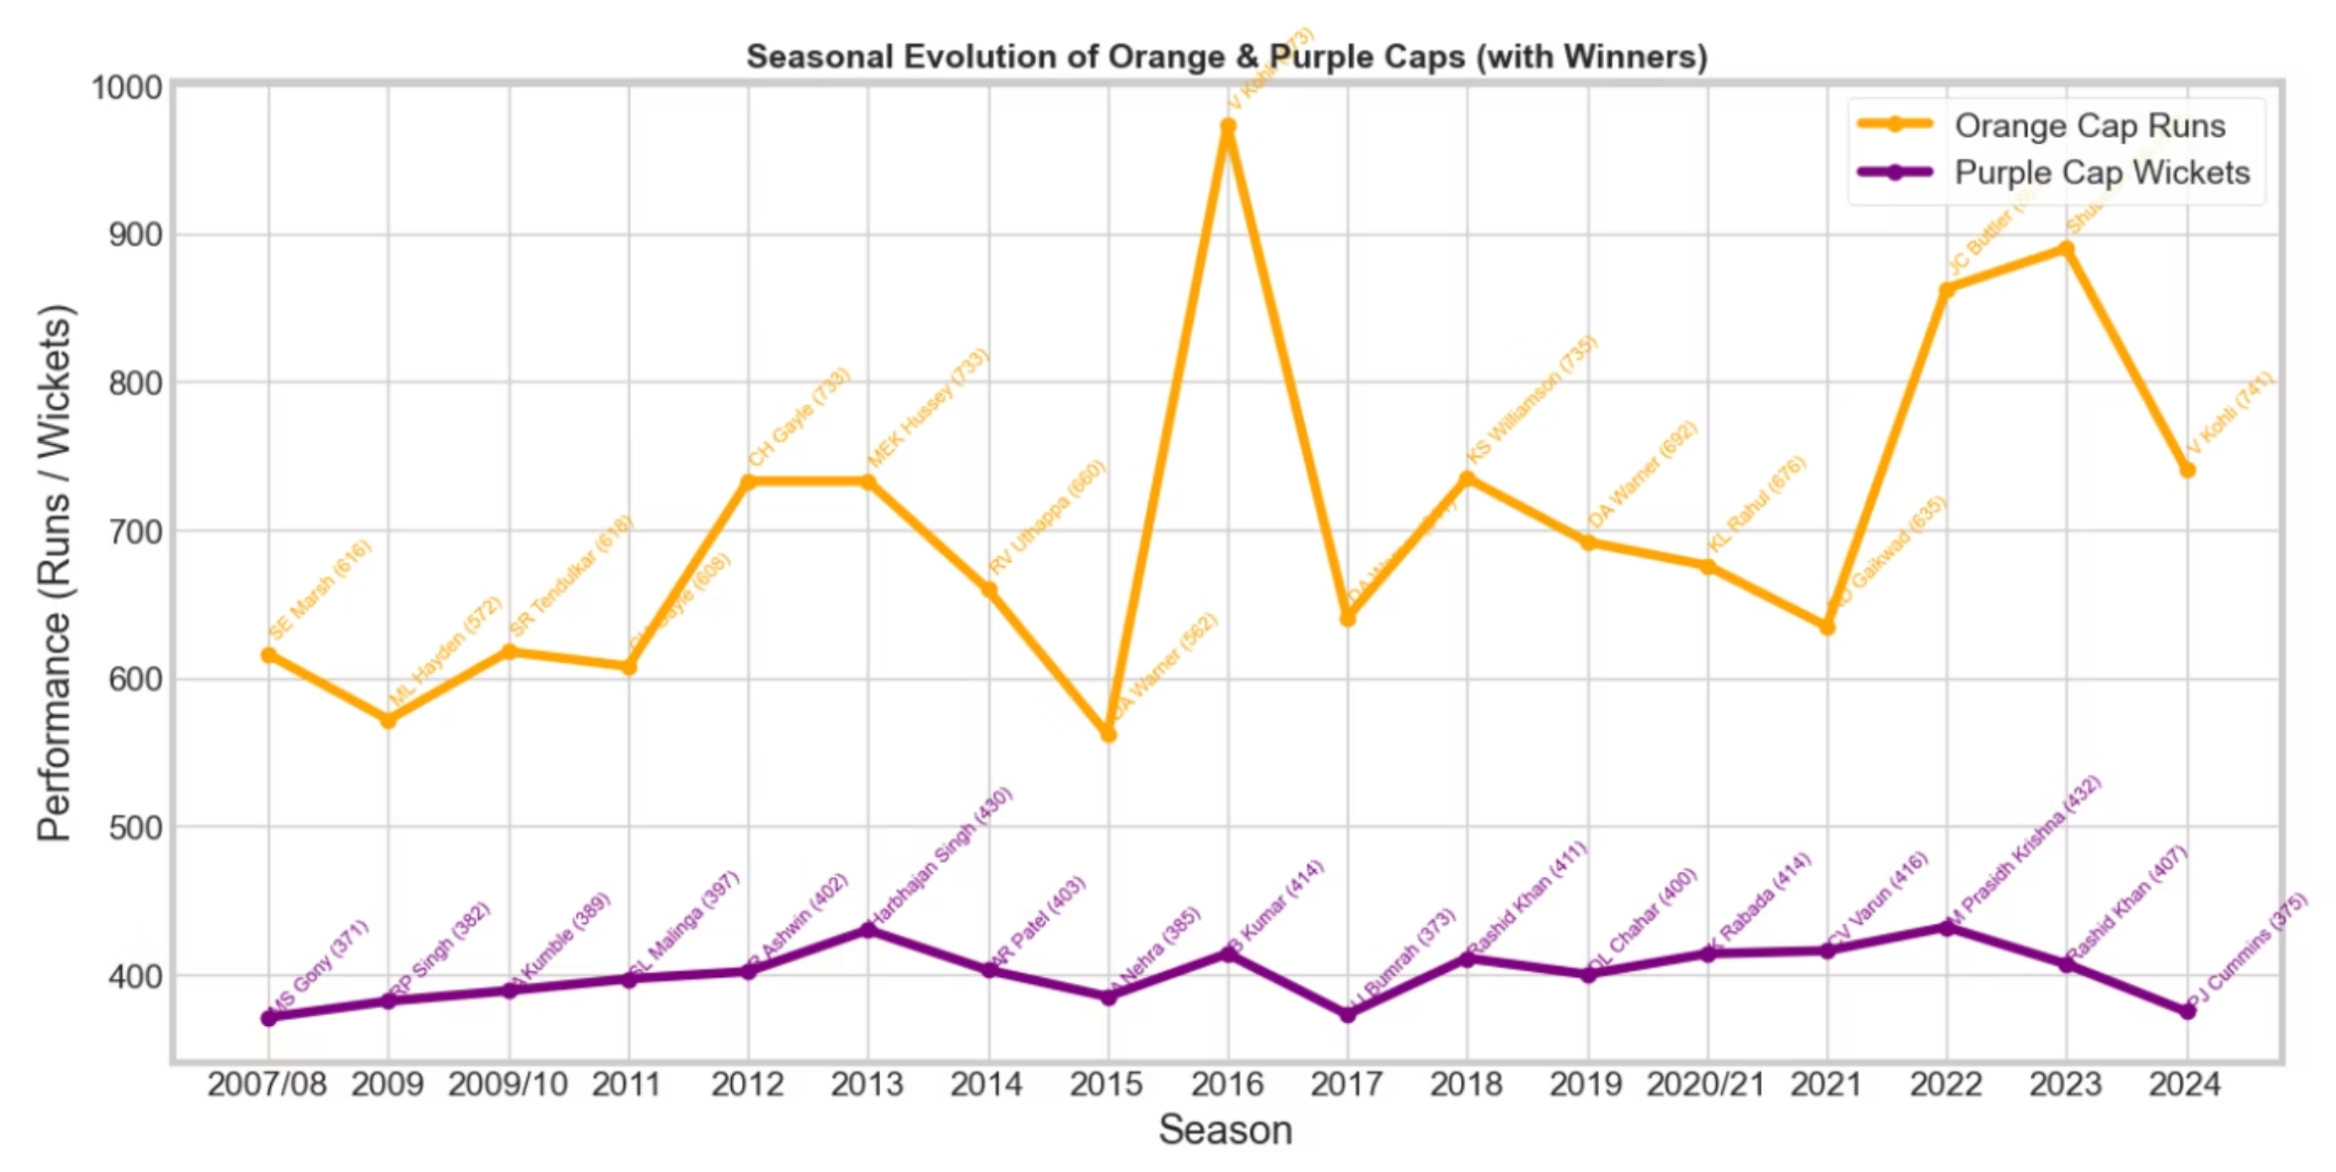
Multi Variate Analysis:
Seasonal Evolution of Orange & Purple Caps
Orange line → Orange Cap runs per season, annotated with winner names + runs.
Purple line → Purple Cap wickets per season, annotated with winner names + wickets.
Every season clearly shows who won the cap and their performance numbers.

Slide 20
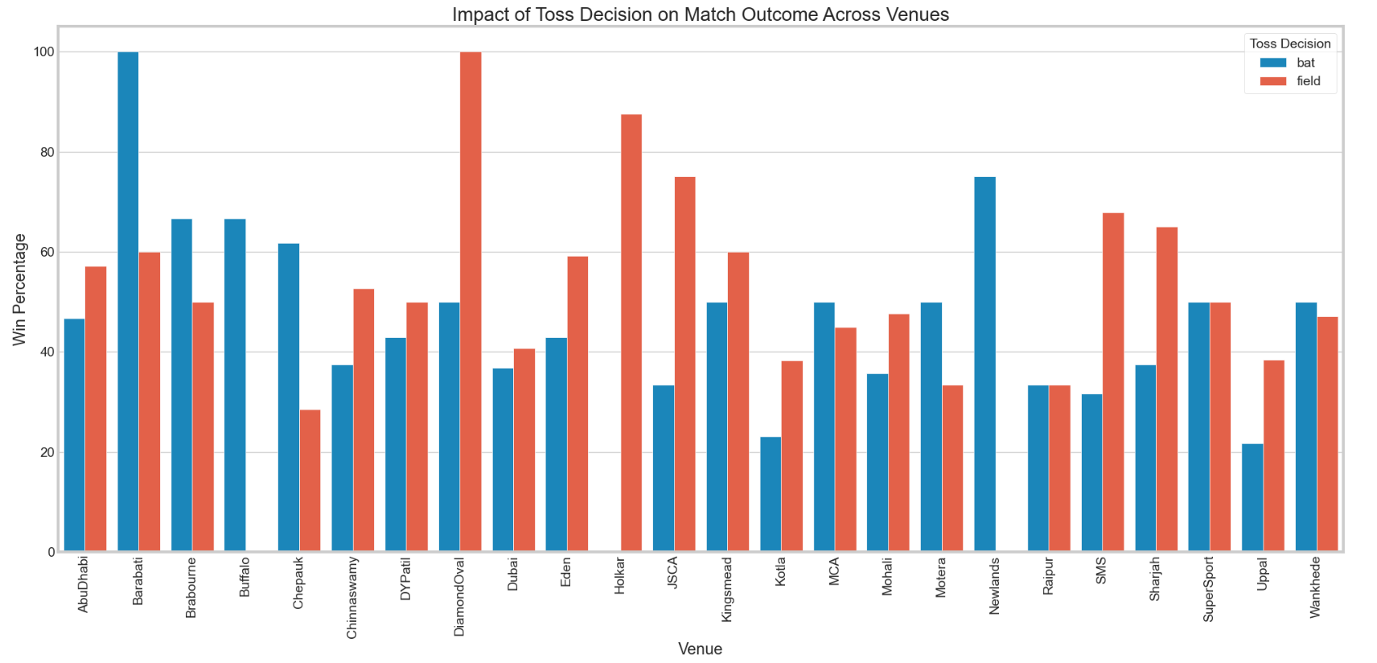
Multi Variate Analysis:
Seasonal Evolution of Orange & Purple Caps
Toss advantage varies by venue, making it a context-dependent factor rather than a guarantee of victory.
Chasing is more successful at dew-affected, high-scoring venues, while batting first works better on slow pitches.
Overall match outcomes depend more on team strength and execution than on the toss alone.

Slide 21
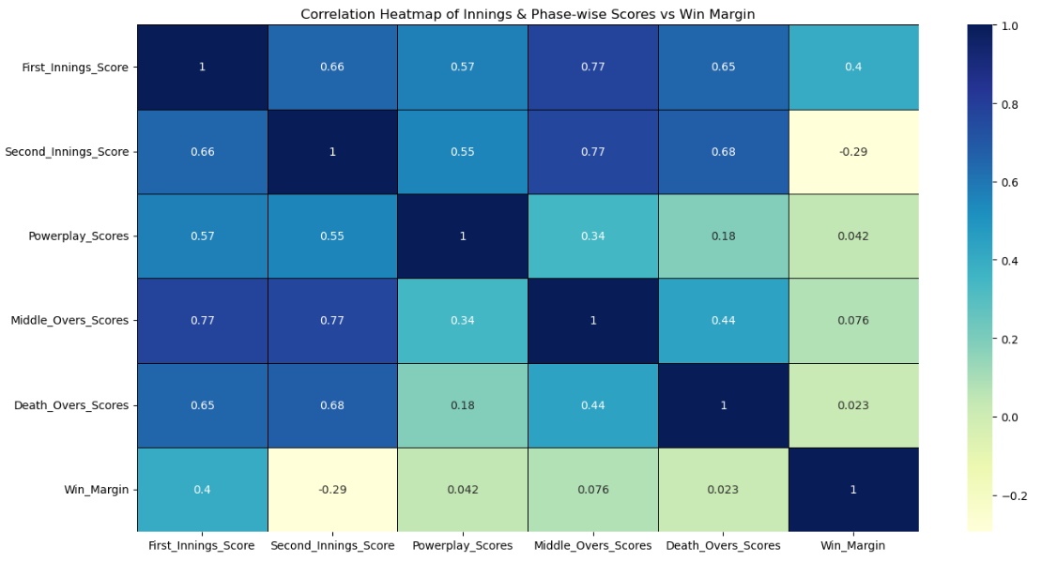
Multi Variate Analysis:
Correlation Heatmap (Innings & Phase-wise Scores)
Phase-wise scores are strongly interrelated, with death overs showing higher variability and influence on overall match dynamics.
Win margin has only weak to moderate correlation with total and phase-wise scores, indicating competitive balance in IPL matches.
Correlation patterns reflect strategic interactions across innings, rather than dominance by any single scoring phase.

Slide 22
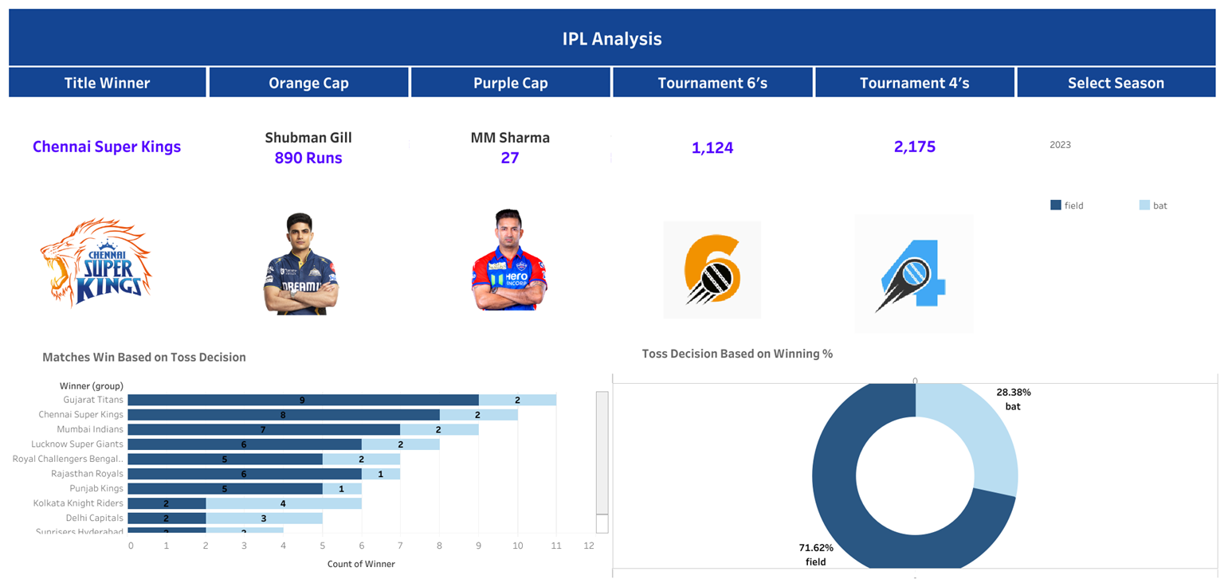
Tableau Dashboard

Slide 23
Future Scope
Build Predictive Models
Time-Series Trend Forecasting
Player Performance Clustering
Win Probability Models

Slide 24
Thank You

